Slide 1
Node.js
Mohamed Omran
Senior Software Engineer @The Fabulous

Slide 2


Slide 3


Slide 4
Questions
Wait for the end of the section
Try to keep your question in context
Listen to others’ questions
Ask repeatedly until you understand

Slide 5
Content
Day 1 Web 101 What is Node.js
Node.js vs Browser
ENV variable, global, REPL, CLI Args
Modules and require
Core Modules

Slide 6
Web 101
Web Server
Protocols
HTTP
Request
Response

Slide 7
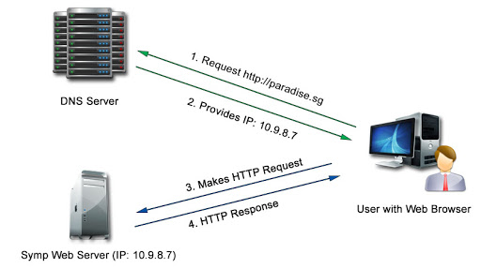
Web 101

Slide 8
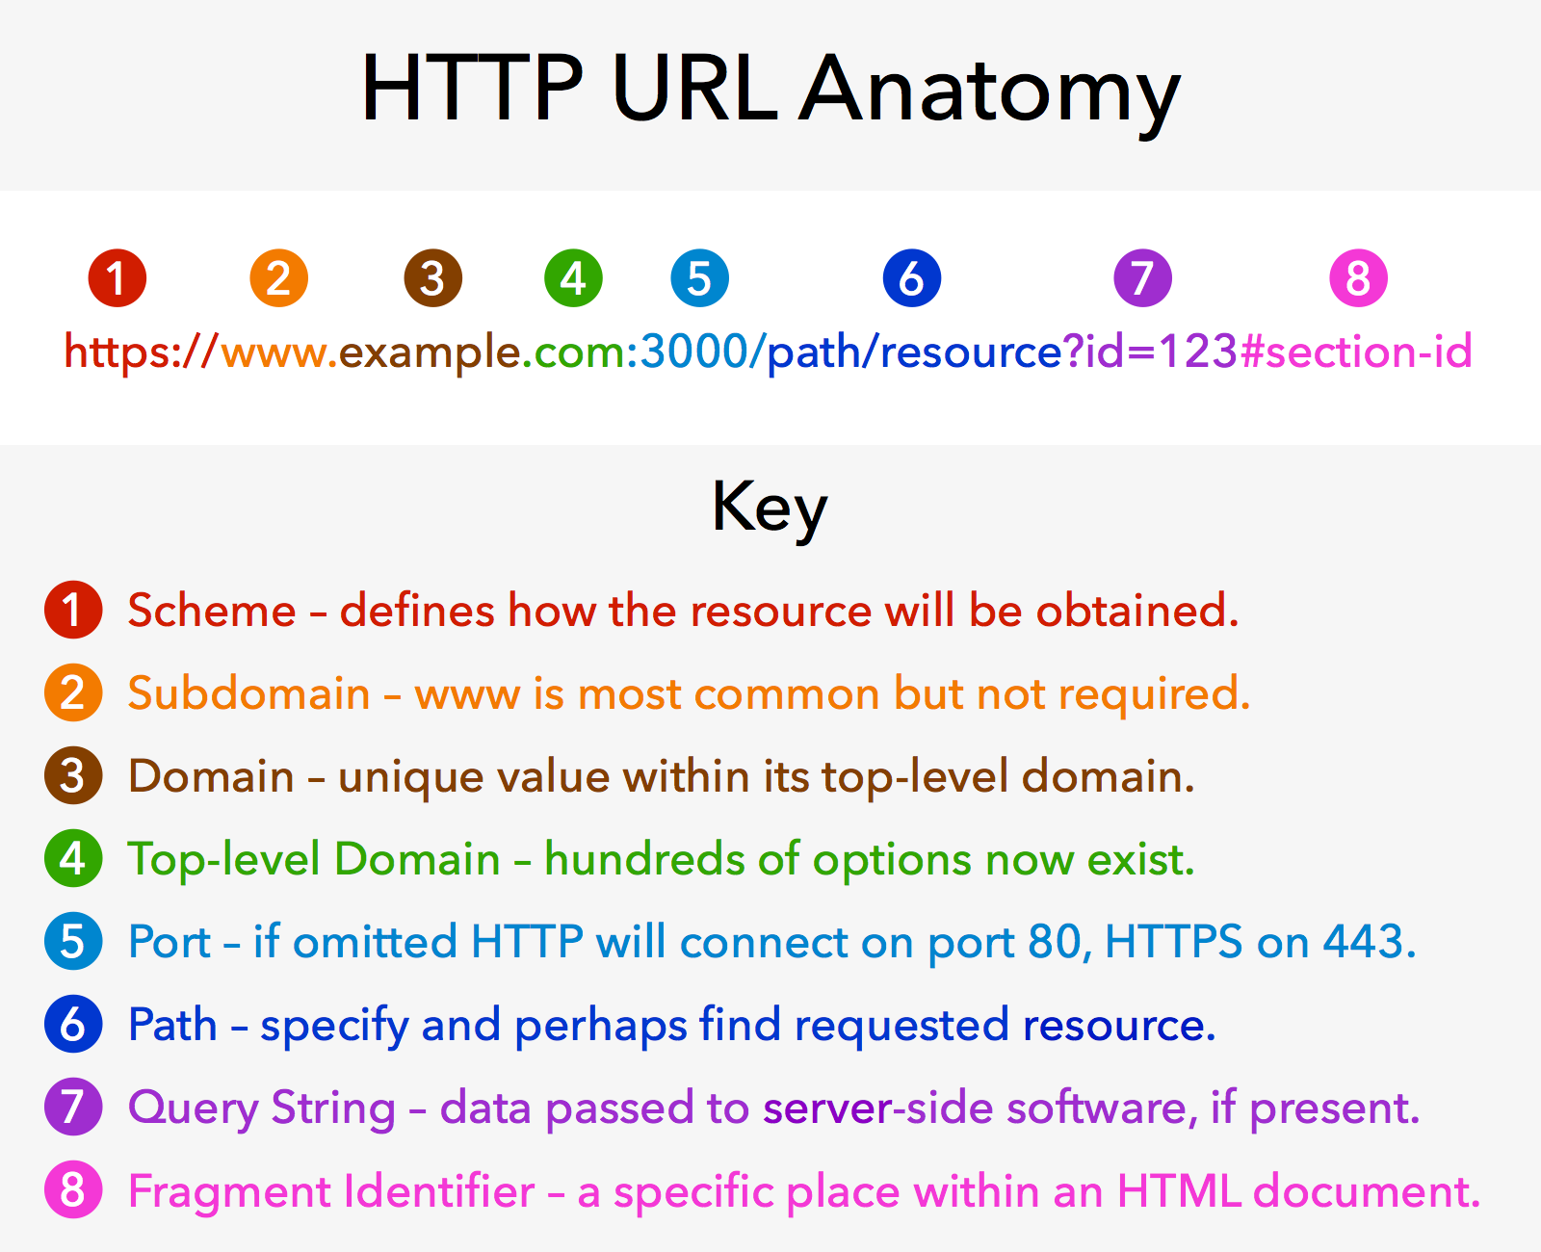
Web 101

Slide 9
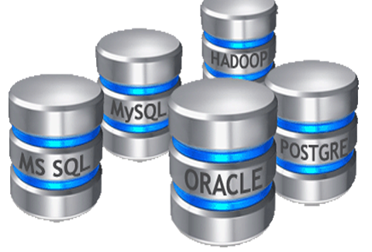
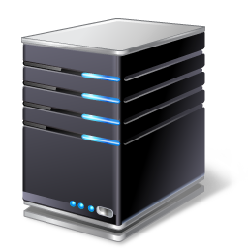


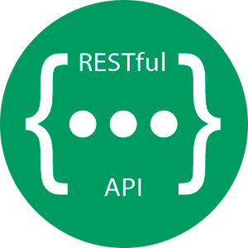

DBMS
(1) HTTP Request
Requests
File System
Web Server
OS
(7) HTTP Response
(6) Fetched data
Application Server (express)
Other Sources

Slide 10
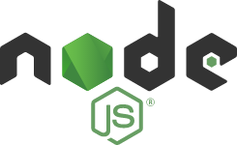
What’s Node.js?
Node.js is an open-source, cross-platform, back-end, JavaScript runtime environment that executes JavaScript code outside a web browser.

Slide 11
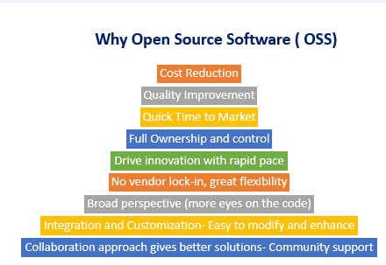
Open source

Slide 12
Requirements
Deal with filesystem.
Deal with network.
Deal with DB.
Accept requests and send responses.
Way to deal with time consuming blocking tasks.
Organize codebase.

Slide 13
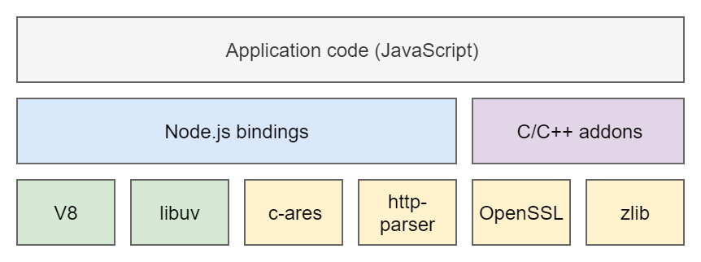
Building a runtime

Slide 14
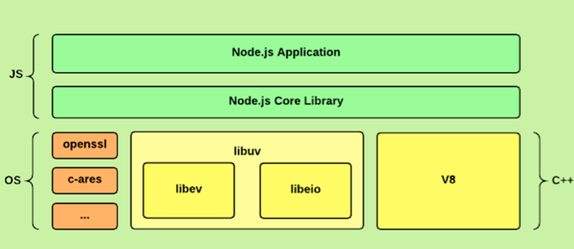
Building a runtime

Slide 15
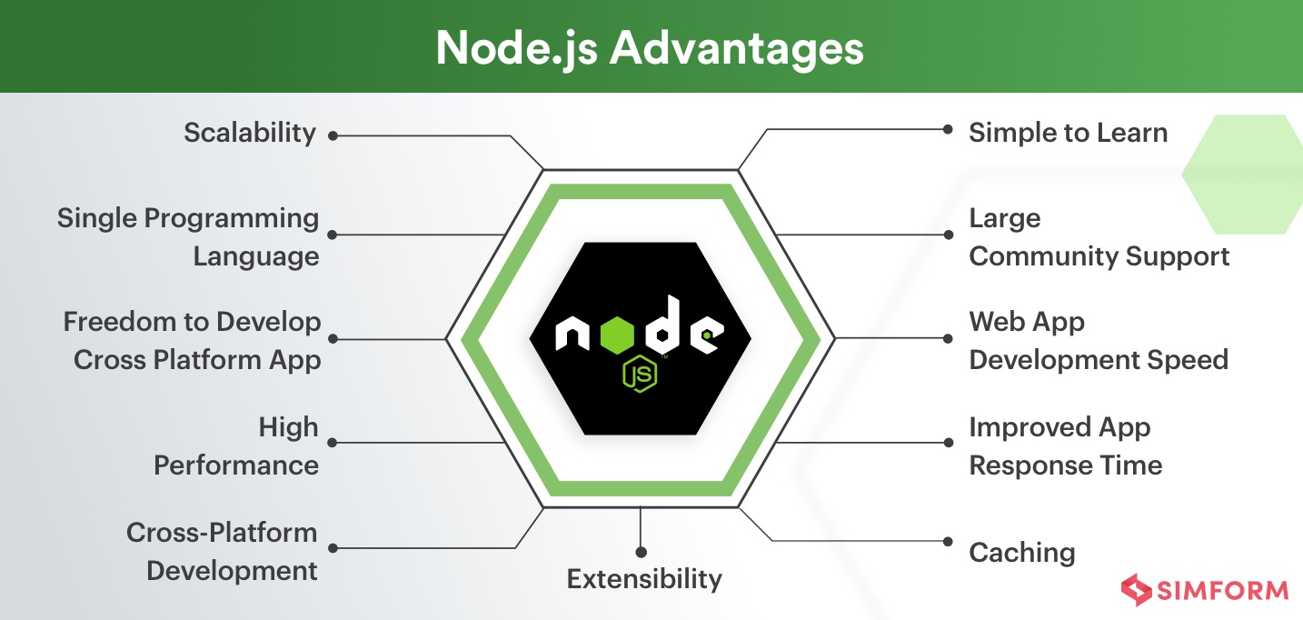
Why using Node.js

Slide 16
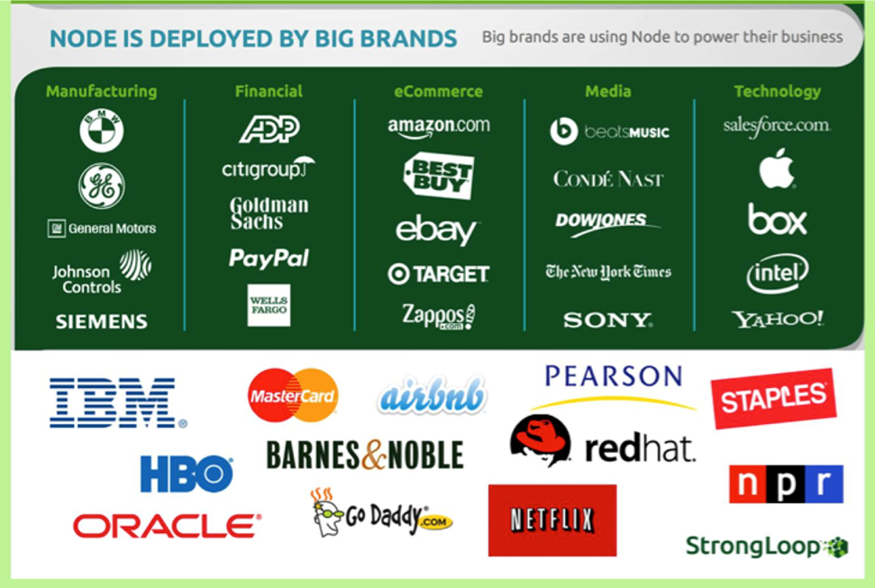
Use in?

Slide 17
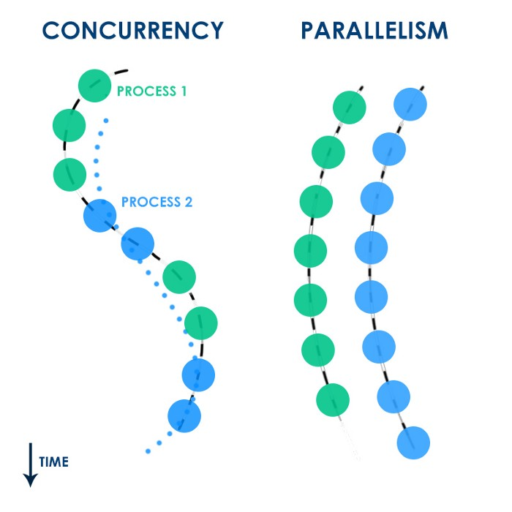
Concurrency VS Parallelism

Slide 18
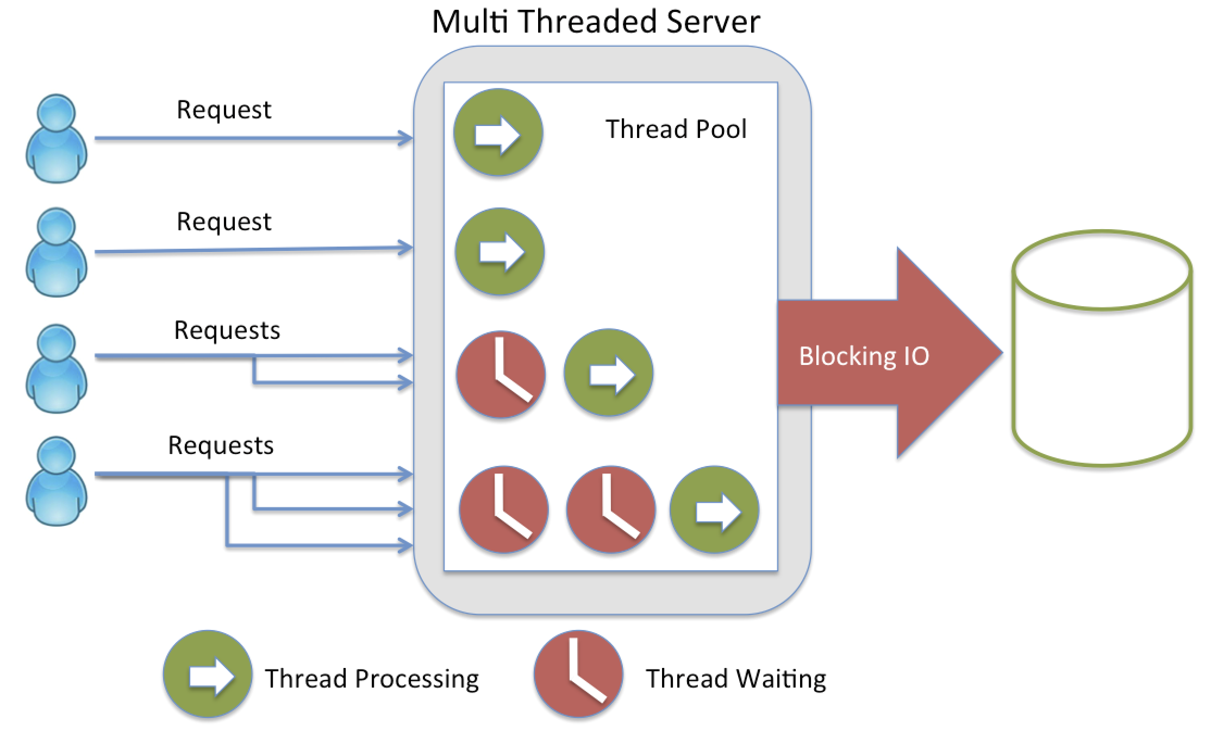
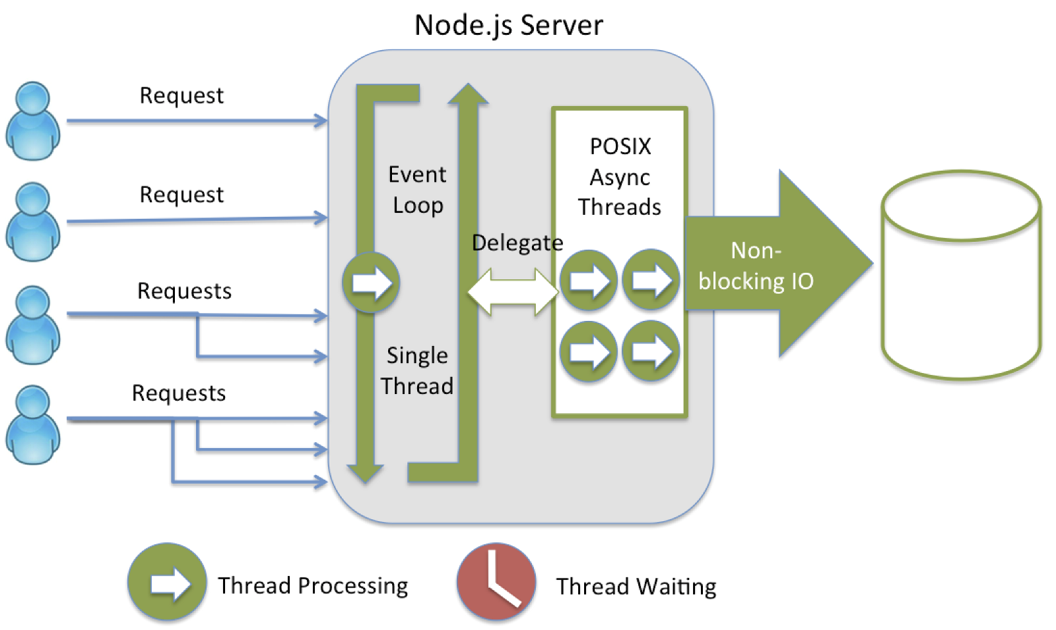

Slide 19
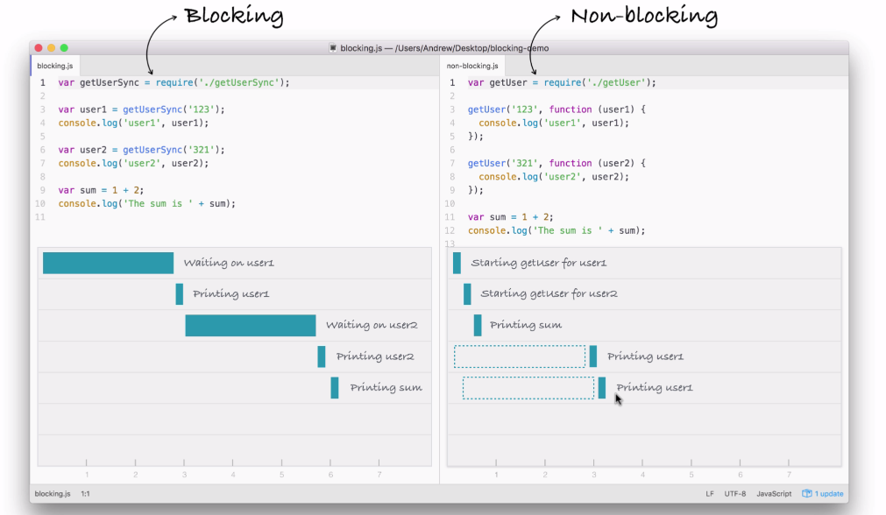
Blocking Vs Non- Blocking Code

Slide 20
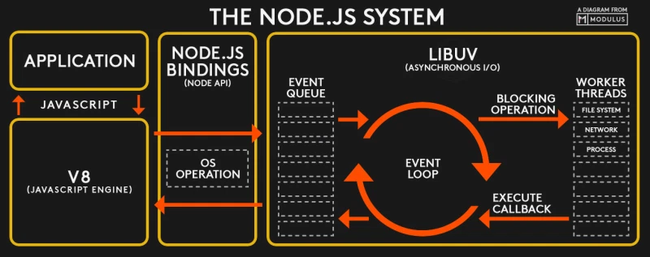

Slide 21
JS in browser and Node.js Node REPL Node Global Objects Environment Variables CLI argv

Slide 22
Core Modules

Slide 23
Modules and require

Slide 24
Building CLI ToDo List
Using fs module

Slide 25
Lab;

